Slide 1

COMPUTER ORGANISATION
(TỔ CHỨC MÁY TÍNH)
INTRODUCTION

Slide 2
Acknowledgement
The contents of these slides have origin from School of Computing, National University of Singapore.
We greatly appreciate support from Mr. Aaron Tan Tuck Choy for kindly sharing these materials.

Slide 3
Policies for students
These contents are only used for students PERSONALLY.
Students are NOT allowed to modify or deliver these contents to anywhere or anyone for any purpose.

Slide 4
Recording of modifications
Minor change in slide 13 (replace new picture)

Slide 5
Why Learn Computer Organisation? (From user to builder)
You want to call yourself a computer scientist/specialist.
You want to build software people use.
You need to make purchasing decisions.
You need to offer “expert” advice.
Hardware and software affect performance
  Algorithm determines number of source-level statements (Programming methodology)
  Language, compiler, and architecture determine machine instructions (COD chapters 2 and 3)
  Processor and memory determine how fast instructions are executed (COD chapters 5, 6 and 7)
Understanding performance (COD chapter 4)

Slide 6
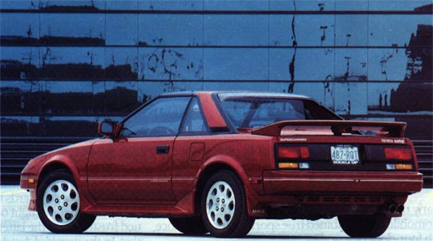

So, what’s a computer? (1/6)
Driver
Example: An automobile augments our power of locomotion.
A computer is a device capable of solving problems according to designed programs. It simply augments our power of storage and speed of calculation.
Programmer

Slide 7
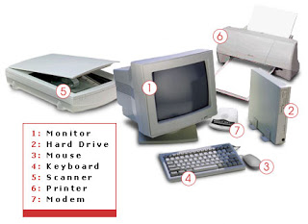
So, what’s a computer? (2/6)
From computer organisation perspective, we study the components and how they work together
  Processor, memory, input/output devices, networks, …
Credit: http://tech4abc.blogspot.sg/2010/08/latest-technology-in-computer-hardwares.html

Slide 8

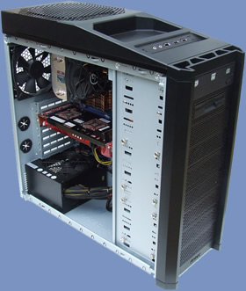
So, what’s a computer? (3/6)
Power supply
Motherboard
Central Processing Unit (CPU)
Random Access Memory (RAM)
Hard drive
Cooling fan
I/O devices
Credit: http://www.overclock3d.net/reviews/cpu_mainboard/the_computer_council_-_clocked_gamer_quad/1
Credit: http://tech3news.com/most-recent-computer-technology/

Slide 9
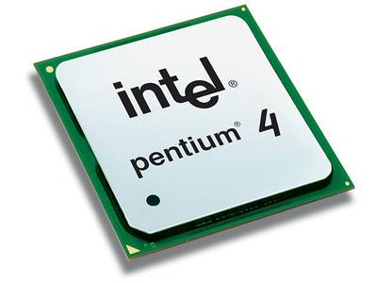
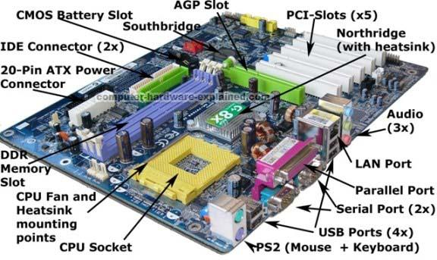
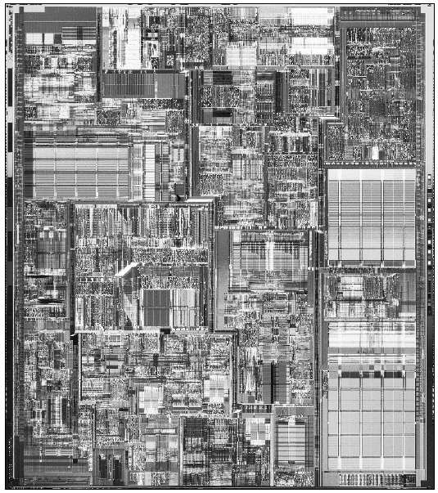
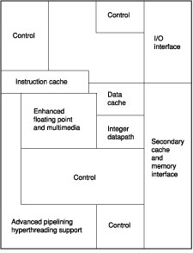
So, what’s a computer? (4/6)
PC motherboard
Pentium processor
Inside a Pentium chip
Credit: http://www.computer-hardware-explained.com/what-is-a-motherboard.html

Slide 10
So, what’s a computer? (5/6)
Computer Organisation
Computer
CPU
Memory
Devices
Control
Input
Datapath
Output

Slide 11
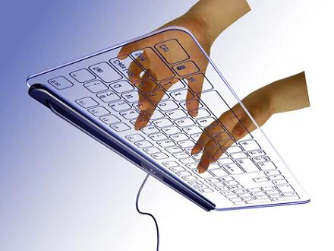

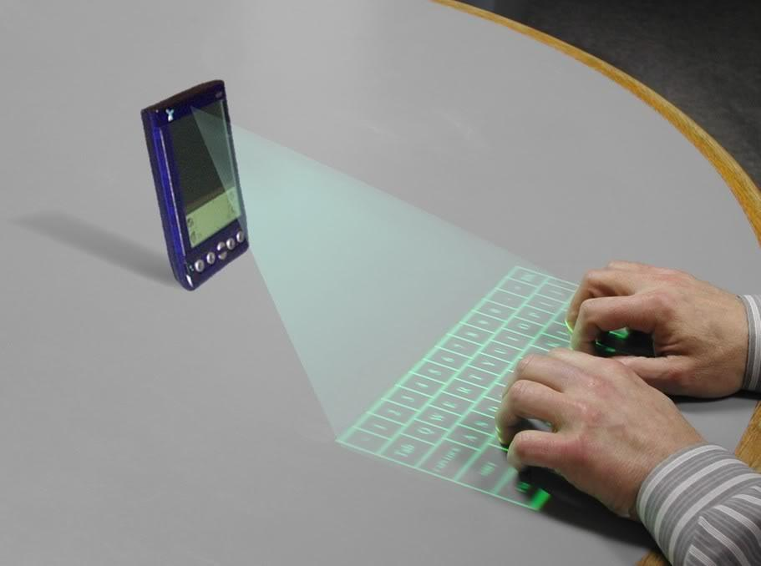
So, what’s a computer? (6/6)
Next generation…
Credit: http://www.custom-build-computers.com/Latest-Computer-Hardware.html
Credit:
http://www.prabhanjamindiaits.com/blogdetailedpage.aspx?id=66
Credit: http://new-techpc.blogspot.sg/2012/10/latest-in-computer-technology.html

Slide 12
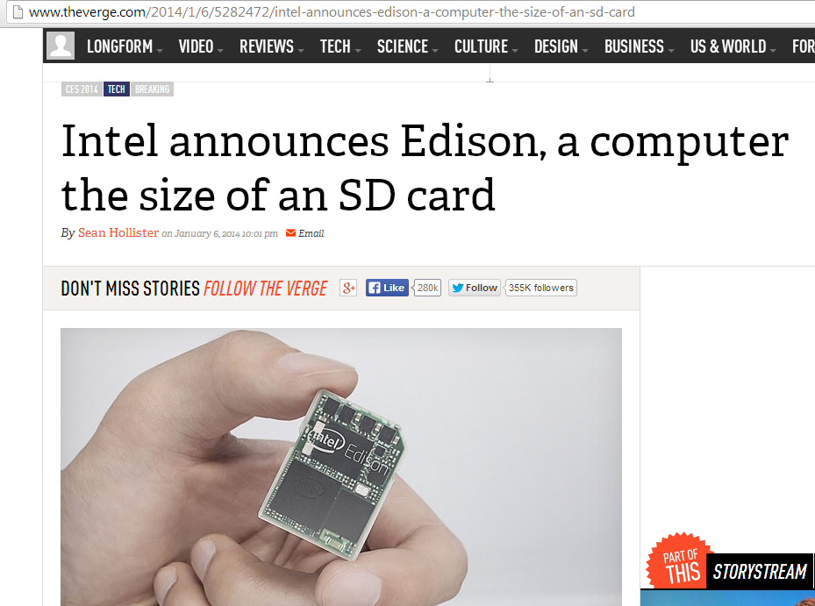
6th January 2014
http://www.theverge.com/2014/1/6/5282472/intel-announces-edison-a-computer-the-size-of-an-sd-card

Slide 13
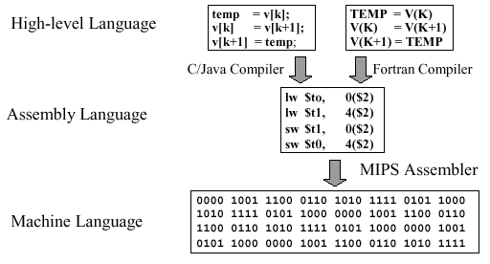
ABSTRACTION (1/2)
Delving into depth reveals more information
Abstraction omits unnecessary details

Slide 14
ABSTRACTION (2/2)
Need to learn abstractions such as:
  Application and system software
  Assembly language and machine language
  Architectural issues such as pipelining, caches, virtual memory
  Combinational logic, arithmetic circuits
  Sequential logic, finite state machines
  Boolean logic (1s and 0s)
  Transistors used to build logic gates (CMOS - Complementary Metal Oxide Semiconductors)
  Semi-conductors/silicon used to build transistors
  Properties of atoms, electrons and quantum dynamics
So much to learn!

Slide 15

HOW DO THE PIECES FIT TOGETHER?
Software
Application (IE, Excel, etc.)
Operating
System
(Windows XP)
Compiler
Assembler
Instruction Set
Architecture
Processor
Memory
I/O system
Datapath & Control
Computer Architecture
Hardware
Digital Design
transistors
Digital Logic Design
Coordination of many levels of abstraction
Under a rapidly changing set of forces
Design, measurement, and evaluation

Slide 16
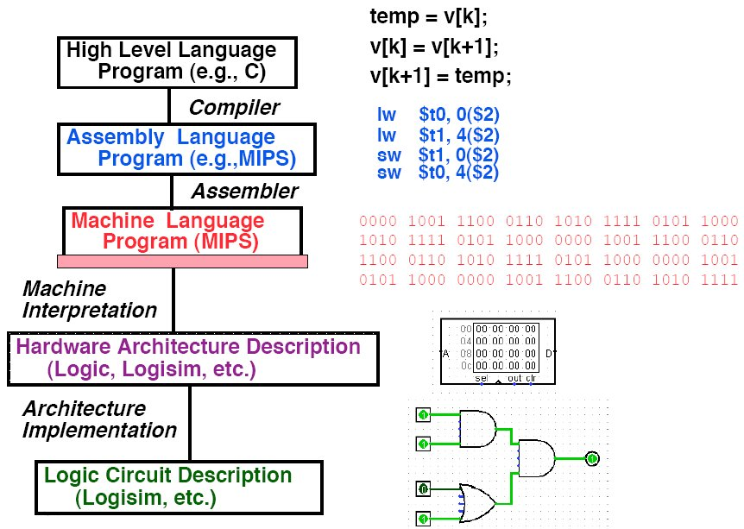
LEVELS OF REPRESENTATION

Slide 17
SYLLABUS OUTLINE (REVISIT)
Number systems and codes
Boolean algebra
Logic gates and circuits
Simplification
Combinational circuits
Sequential circuits
Performance
Assembly language
The processor: Datapath and control
Pipelining
Memory hierarchy: Cache
Input/output
Preparation: 2 weeks
Logic Design: 3 weeks
Computer organisation
CS2100
Introduction
‹#›
Notes:
‹#›

Slide 18
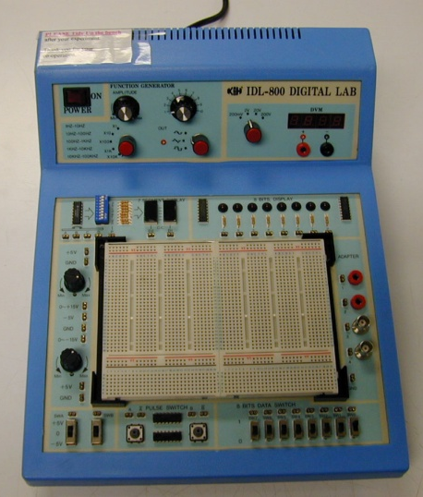
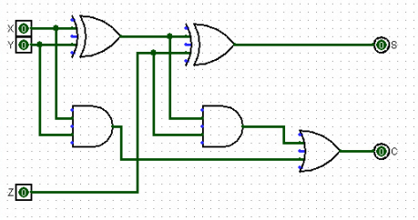
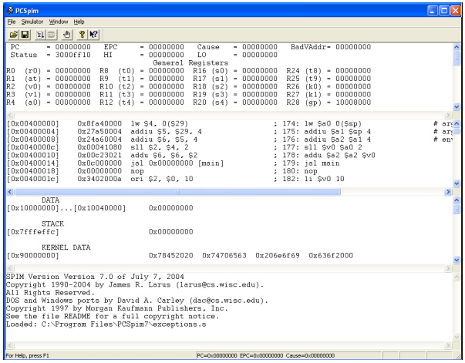
PRACTICAL ASPECTS
Practical experience
  Logic design experiments
  Logisim software
  PC Spim software

Slide 19
QUOTES
“What I hear, I forget.
What I see, I remember.
What I do, I understand”
“The important thing is to understand what you are doing, rather than to get the right answer” – Tom Lehrer

Slide 20
Q&A

